Slide 1
youv
Team Winnovators
August 18th, 2017
Notes:
Phil

Slide 2

INTRODUCTION VIDEO
Notes:
Phil

Slide 3
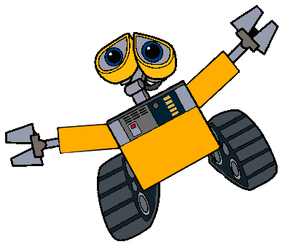
Motivation & Background
Notes:
Sal

Slide 4
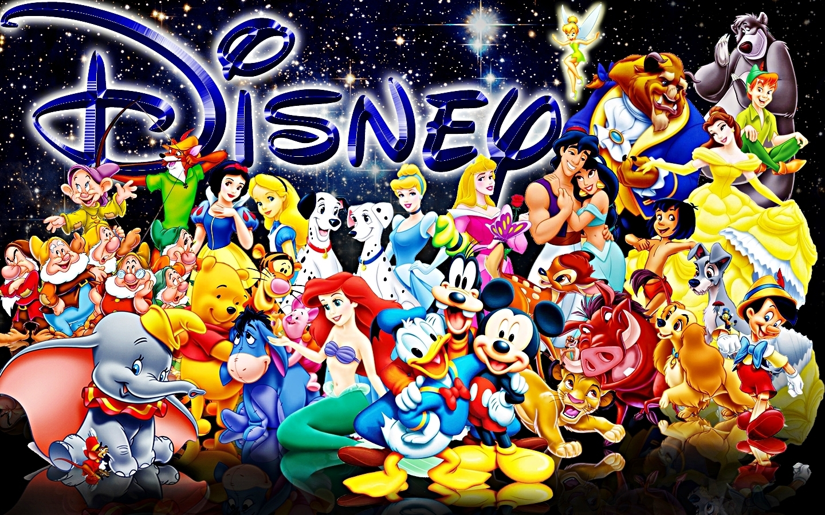
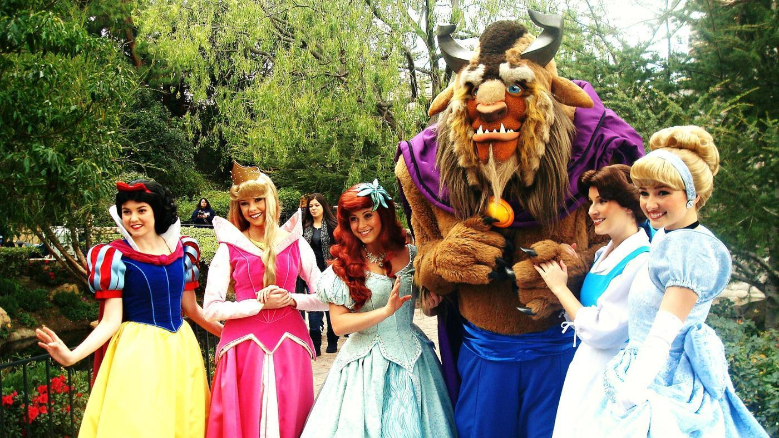
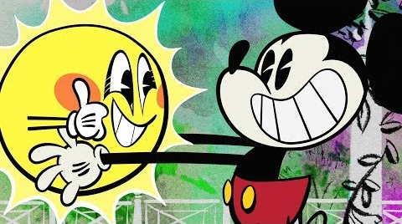
The Threat Melanoma Poses to Disney
Over 70,000 Cast Members in Florida
2,640+ hours of sun exposure a year for park workers
No current Disney sun-care or melanoma prevention initiatives
Notes:
Sal
For places like Disney, who make their living off of all of this fun in the sun, there is a huge risk to their employees of skin cancer
1. Disney has over 70,000 Cast Members in Florida
2. Park workers typically work 6 days a week, 8 – 10 hours per shift
55+ hours of sun exposure a week, 220+ hours a month, 2,640+ hours a year
Many jobs are located in direct sunlight with no cover
3. No current Disney sun-care or melanoma prevention-centric initiatives for Cast Members
But clearly, Disney cares about the health of their cast members…
http://wdwnews.com/fact-sheets/2014/10/31/walt-disney-world-fun-facts/
http://cp.disneycareers.com/en/onboarding/fl/working-here/overview/

Slide 5
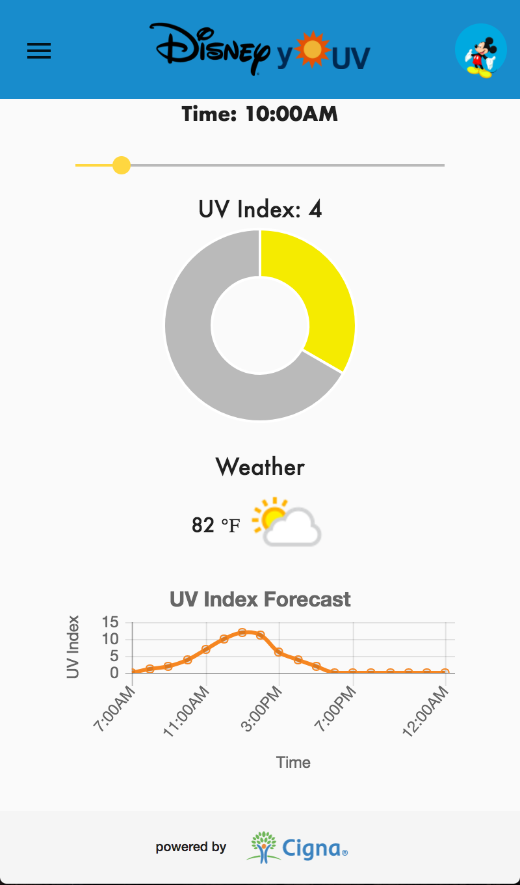
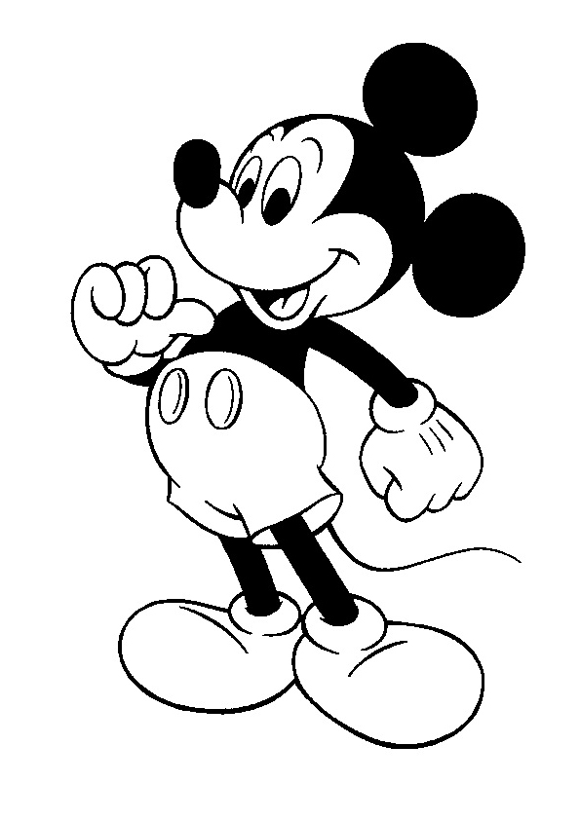

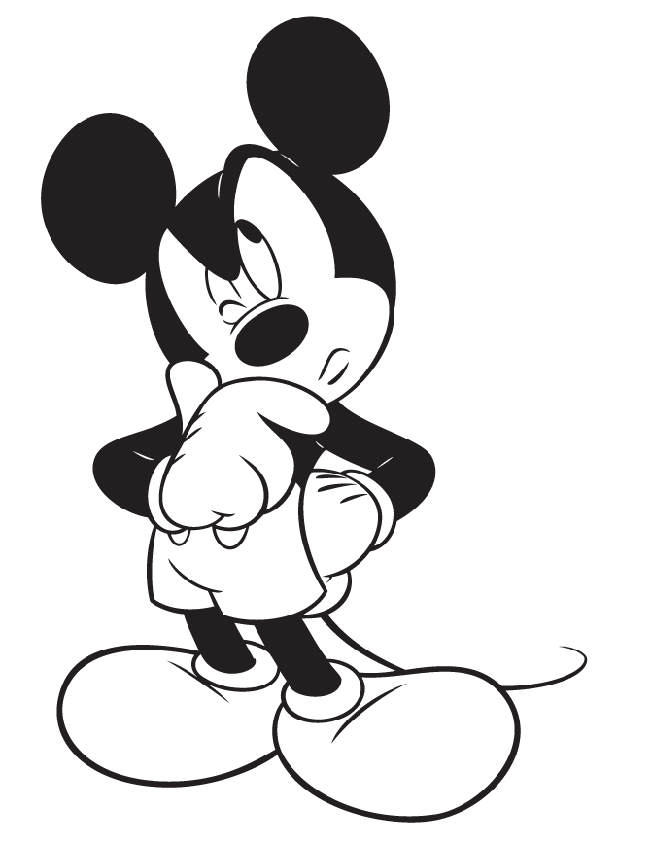

yoUV - Introduction
Proactive melanoma prevention application integrated with the Disney cast member application
Targeted towards Disney cast members who are Cigna customers
Informative
Personalized
Easy to use
Incentives
Notes:
Sal
Inform users about UV and sun strength, Educational, promotes melanoma awareness, Aides in active melanoma prevention efforts (self check walkthroughs and mole tracking)
Personalized to user’s skin type and preferences
Easy to use, integrated, convenient
Incentivizes use through linking to Cigna insurance benefits and Disney rewards/benefits (one day off a year)

Slide 6
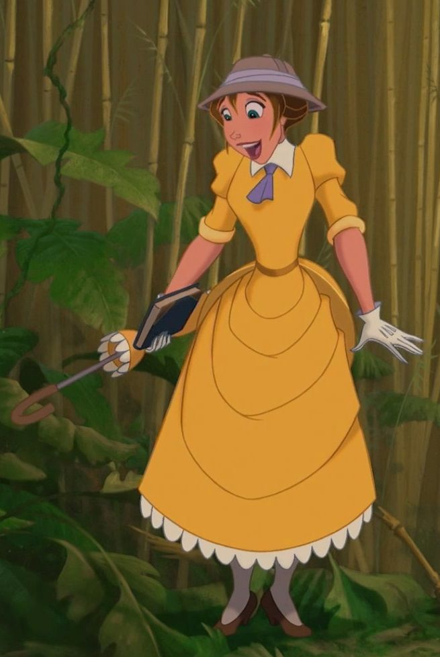
Persona Introduction- Jane
Spending this summer in Orlando in the Animal Kingdom
Worried about sun exposure without her trusty umbrella and the jungle canopy
Wants to use her new iPhone to help keep her skin healthy
Notes:
Sal
Jane is working this summer in Orlando, working the safari in the Animal Kingdom.
However, she won’t be able to take her trusty umbrella with her to protect her against the harsh sun.
Recently, she has traded in her notebook for an iPhone and wants to use it to help keep her skin healthy.

Slide 7
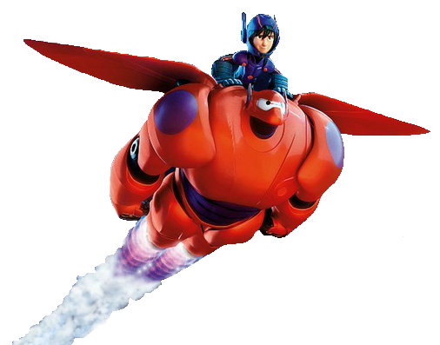
APPLICATION DEMO
Notes:
Brian

Slide 8





Tech Stack
Structure
HTML, CSS, TypeScript, Angular
Data Storage
Mongo DB
Notes:
Phil

Slide 9
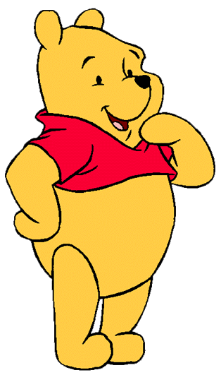
Disney Cast Member Testimonials
“Really great idea! I can definitely see [the app] being used in summer at Disney.”
-Anonymous Disney Health Coach
“[The app] is absolutely very useful, especially at Disney with a lot of members out in Florida where the sun is out all the time; the functions would be great!”
-Nicarla, Disney Health Coach
“This population is more likely to have a smart phone than a computer at home, and this application would be really beneficial, especially to young people that start off [working] in the park.”
-Riann, Disney Health Coach
“The app sounds useful, people love having resources. There are so many people that work [at Disney], it’s very hot, and it definitely could be of benefit to help people know what days the sun might be harmful.”
-Anonymous Disney Health Coach
Notes:
Phil

Slide 10

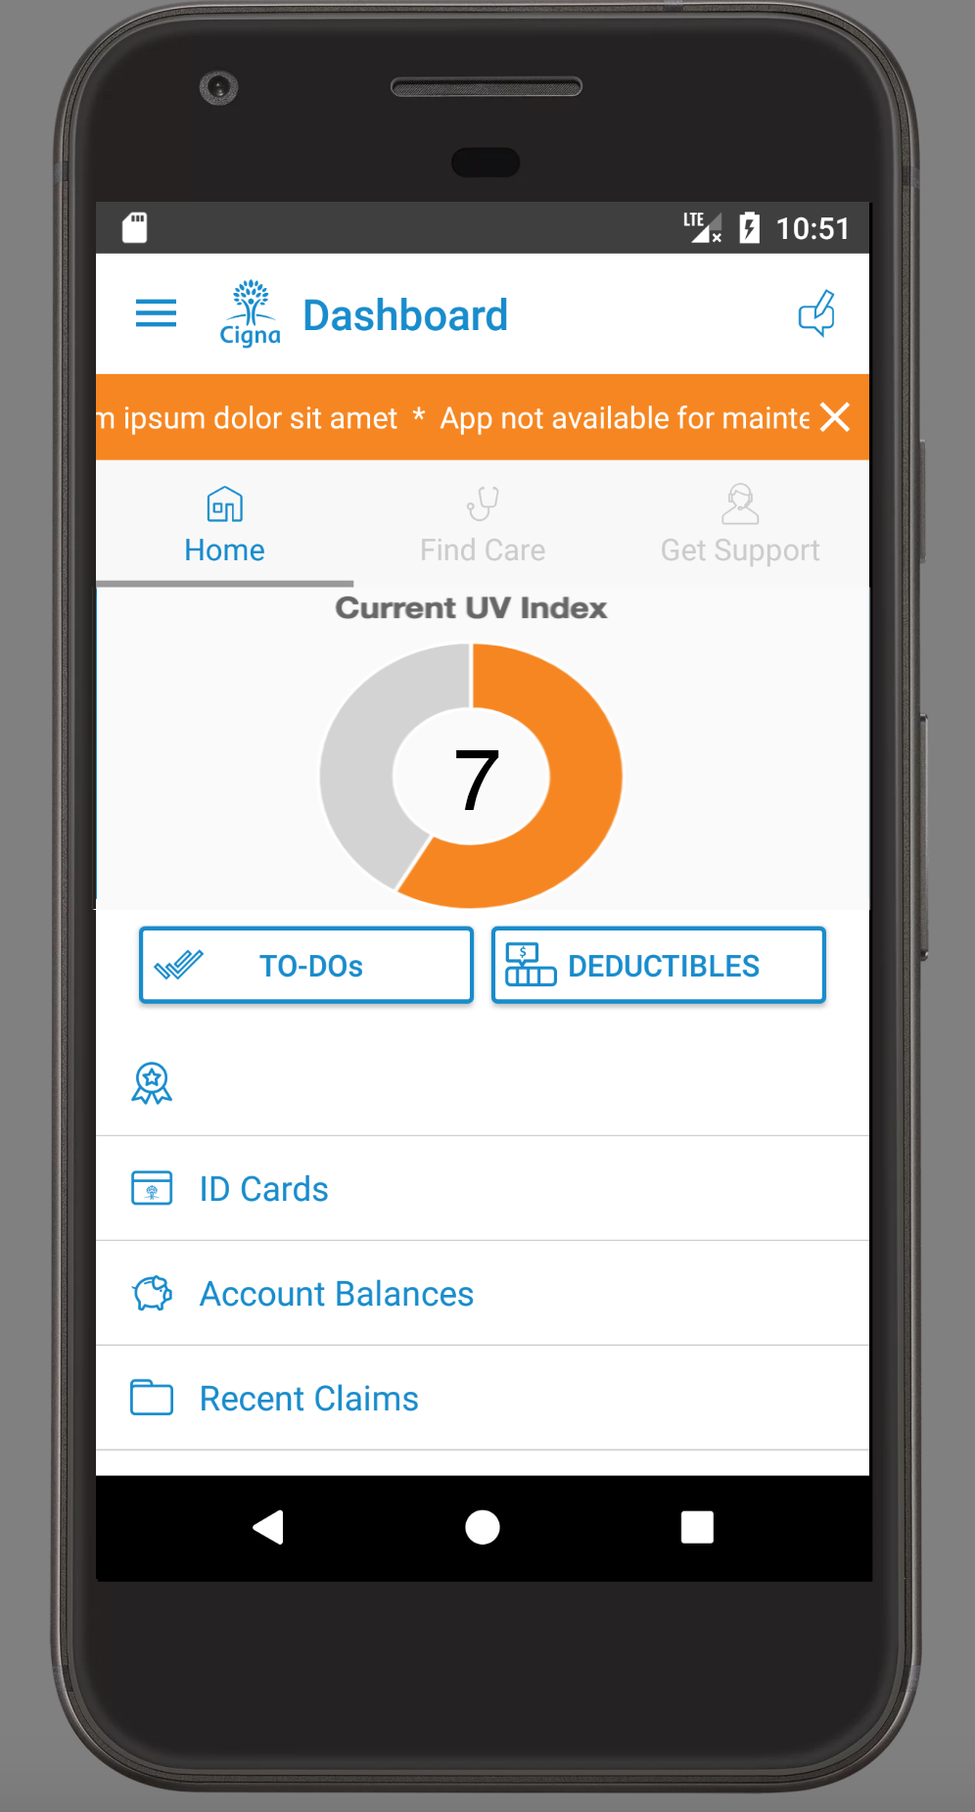
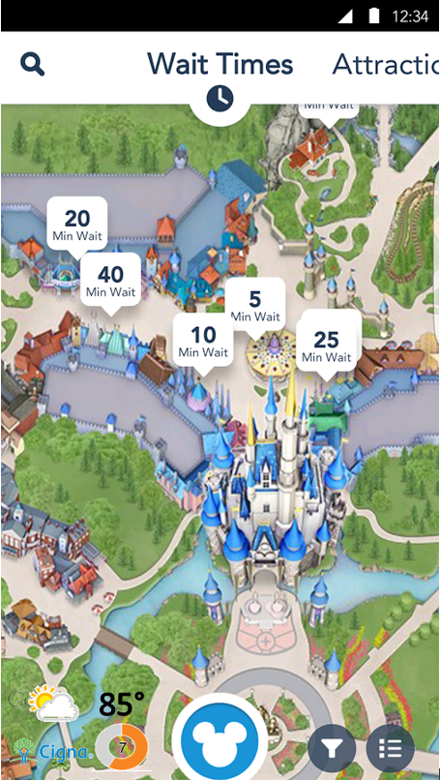
Future Innovations
App Features
Utilize data mining and machine learning to analyze pictures of consumer moles and determine if they are cancerous
Mobile wellness centers situated throughout the park to aide in skin cancer awareness for consumers
Expand beyond the application by integrating into the My Disney Experience application or the My Cigna application
Notes:
Phil
https://lh3.googleusercontent.com/7rhCo8Y5fNM1fIvzSRj5k3XwROMF7bqkka_G4LUXJyN_TnnSFjT18dwX_mJB5TbYWA4=h310

Slide 11

Business Plan
Notes:
Josie

Slide 12

5-Year Plan of Action
Year 1 – Establish Contract with Disney
Year 3 - Pilot
Year 4 – Deploy to Disney World Cast Members
Year 2 – Application Development
Year 5 – Deploy to all US Disney Cast Members
Notes:
Josie
Year 1 – establish contract with Disney
Identify client interest, work out any requirements they may have
Determine process for business approval, steps for integration with Disney and application development
Work out issues including business sponsorship, who would have ownership of the app, security issues, data collection issues, app architecture, integration between the two apps, and the support model for who would support the application and handle maintenance
Determine funding – potentially use Cigna Innovation funds?
Get contract signed btw the two companies
Year 2 – Application development
Finish full application development, and add any wanted additional functionality
Year 3 – pilot
6-month pilot with 3,000 cast members who work in the park and Disney health coaches at Disney World in Orlando with monthly feedback reviews
Second 6-month pilot with 10,000 cast members in Disney World Orlando, continued monthly feedback reviews
Year 4 – deployment to small sub group
Deploy app to all cast members in Orlando location, do survey of users and continue to tweak app to their needs
Year 5 – deployment to everyone
Deploy app to all US cast members, including CA and HI

Slide 13
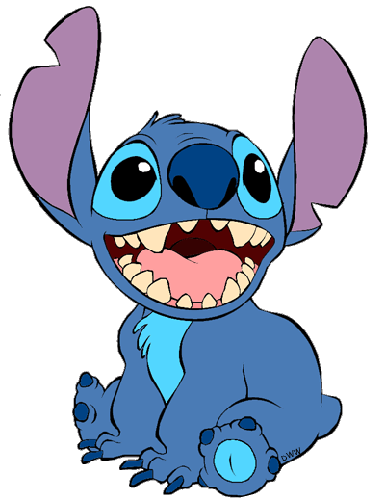
Cost to Develop
Category | Cost
Year 1 | N/A
Year 2 | $350,000
Year 3 | $670,000
Year 4 | $1,650,000
Year 5 | $2,650,000
Total over 5 years | $5,320,000
Notes:
Josie
http://www.sherweb.com/blog/total-cost-of-ownership-of-servers-iaas-vs-on-premise/
Majority of the cost comes from the incentives plan
Includes developing and maintenance costs along with such things as our testing, and our two pilots

Slide 14

How much does this save Cigna?
Over the course of 5 years, this application will save Cigna over $1 million
The application will save 2,500 people from dying due to late stage Melanoma
Notes:
Josie
Over the course of 5 years this application will save Cigna over $1 million dollars from savings in Melanoma treatment costs
Assuming 50,000 users and a 25% reduction in treatment costs.
Moreover, it will save 2,500 of those 50,000 people from dying due to late stage melanoma
Assumes a 25% reduction in treatment costs with 50,000 users at year 5
Assumes 50,000 users, 2% of those in late melanoma, and save 25% of them from our app
https://www.ncbi.nlm.nih.gov/pmc/articles/PMC4495902/#R16
https://www.aad.org/media/stats/conditions/skin-cancer
https://seer.cancer.gov/archive/csr/1975_2011/browse_csr.php?sectionSEL=3&pageSEL=sect_03_table.08.html#table3

Slide 15
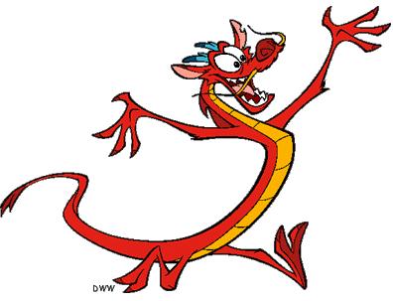
Novelty & Value
Notes:
Josie

Slide 16

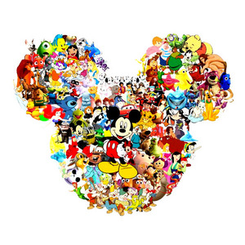
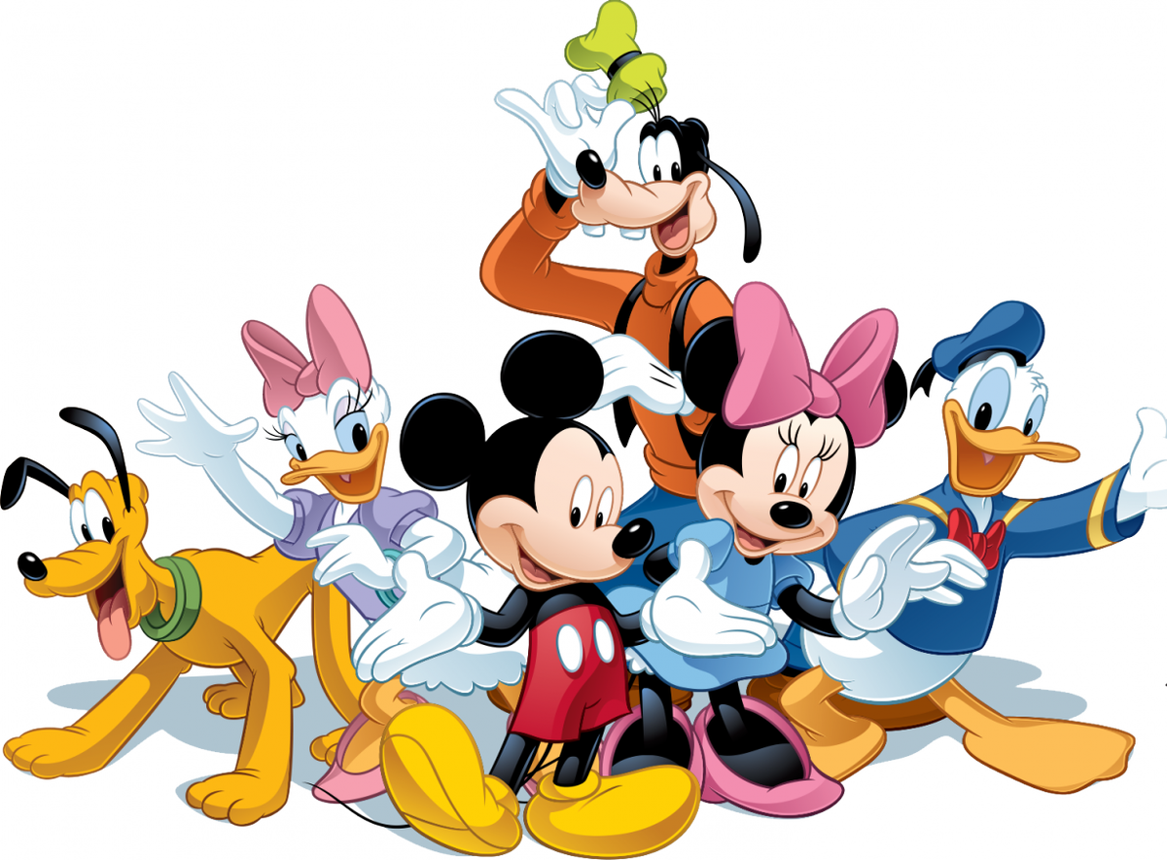
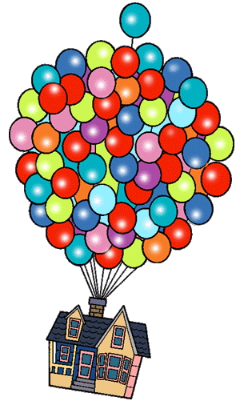
Novelty & Value
+
Shared benefits between Cigna and Disney
Applicable to a wide audience
Expandability and room for future use
Notes:
Josie
Very applicable to a wide audience - Melanoma and sun-care cuts across all ages, genders, ethnicities and locations
Mutual shared benefits between Cigna and Disney
Allows Disney to display their care for their cast members health
Improved health of their cast members
Leads to improved cast member efficiency, work ethic and happiness
Cigna brand awareness and community outreach
Innovative company with bright ideas and bigger and better health-centric products for our customers
Saves both companies money!
With this application, theres no where to go but Up!
Room for growth to include other diseases and conditions, Eg. Asthma with pollution levels and dust or pollen counts
Additional health-related reminder, Eg. Drinking water
Additional self-check walkthroughs for other cancers or conditions Eg. For ticks or breast cancer
Expand customer base, Integrate with other clients

Slide 17
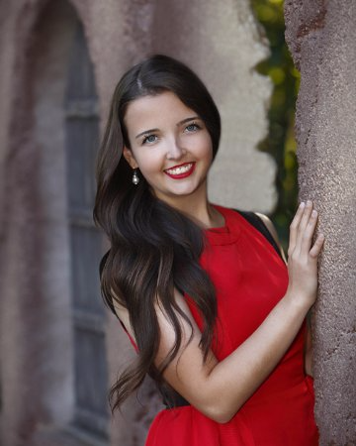
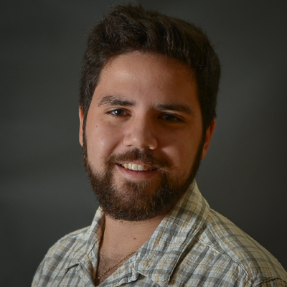
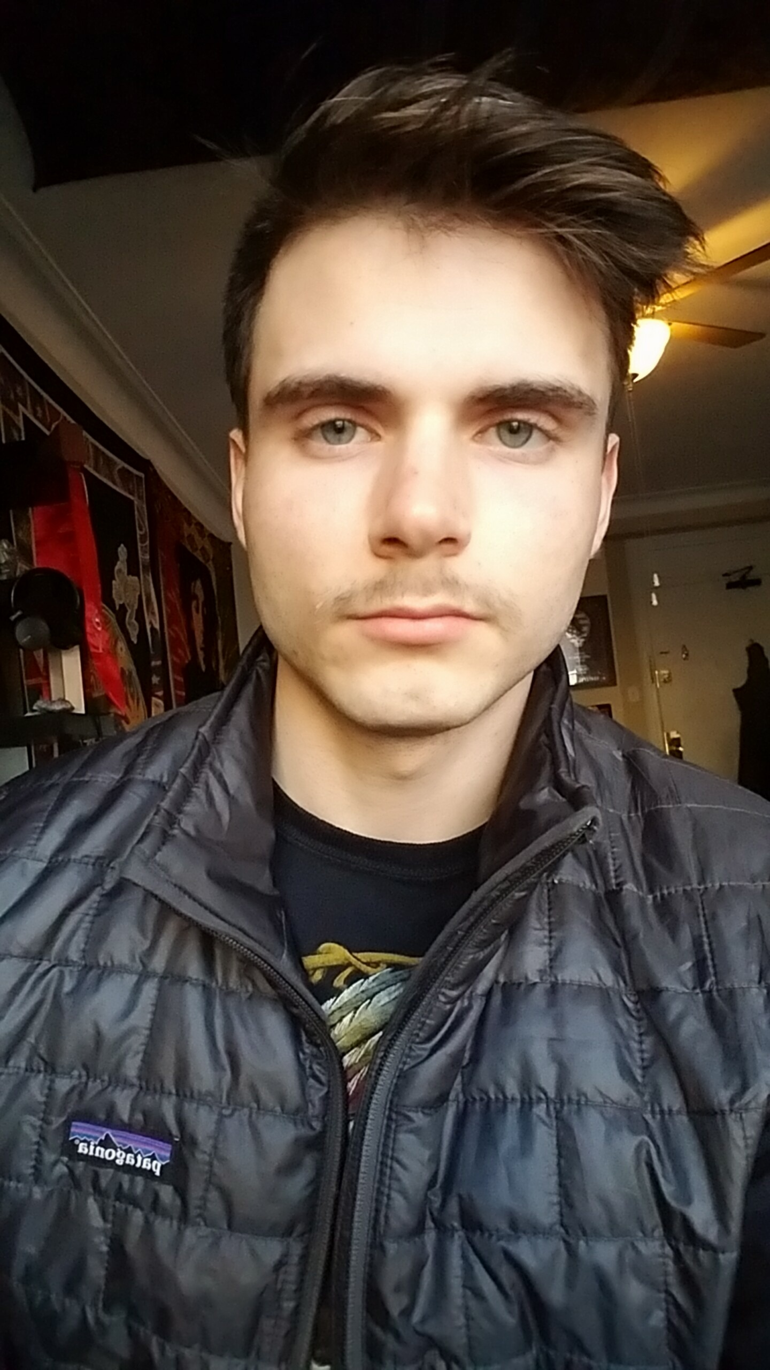
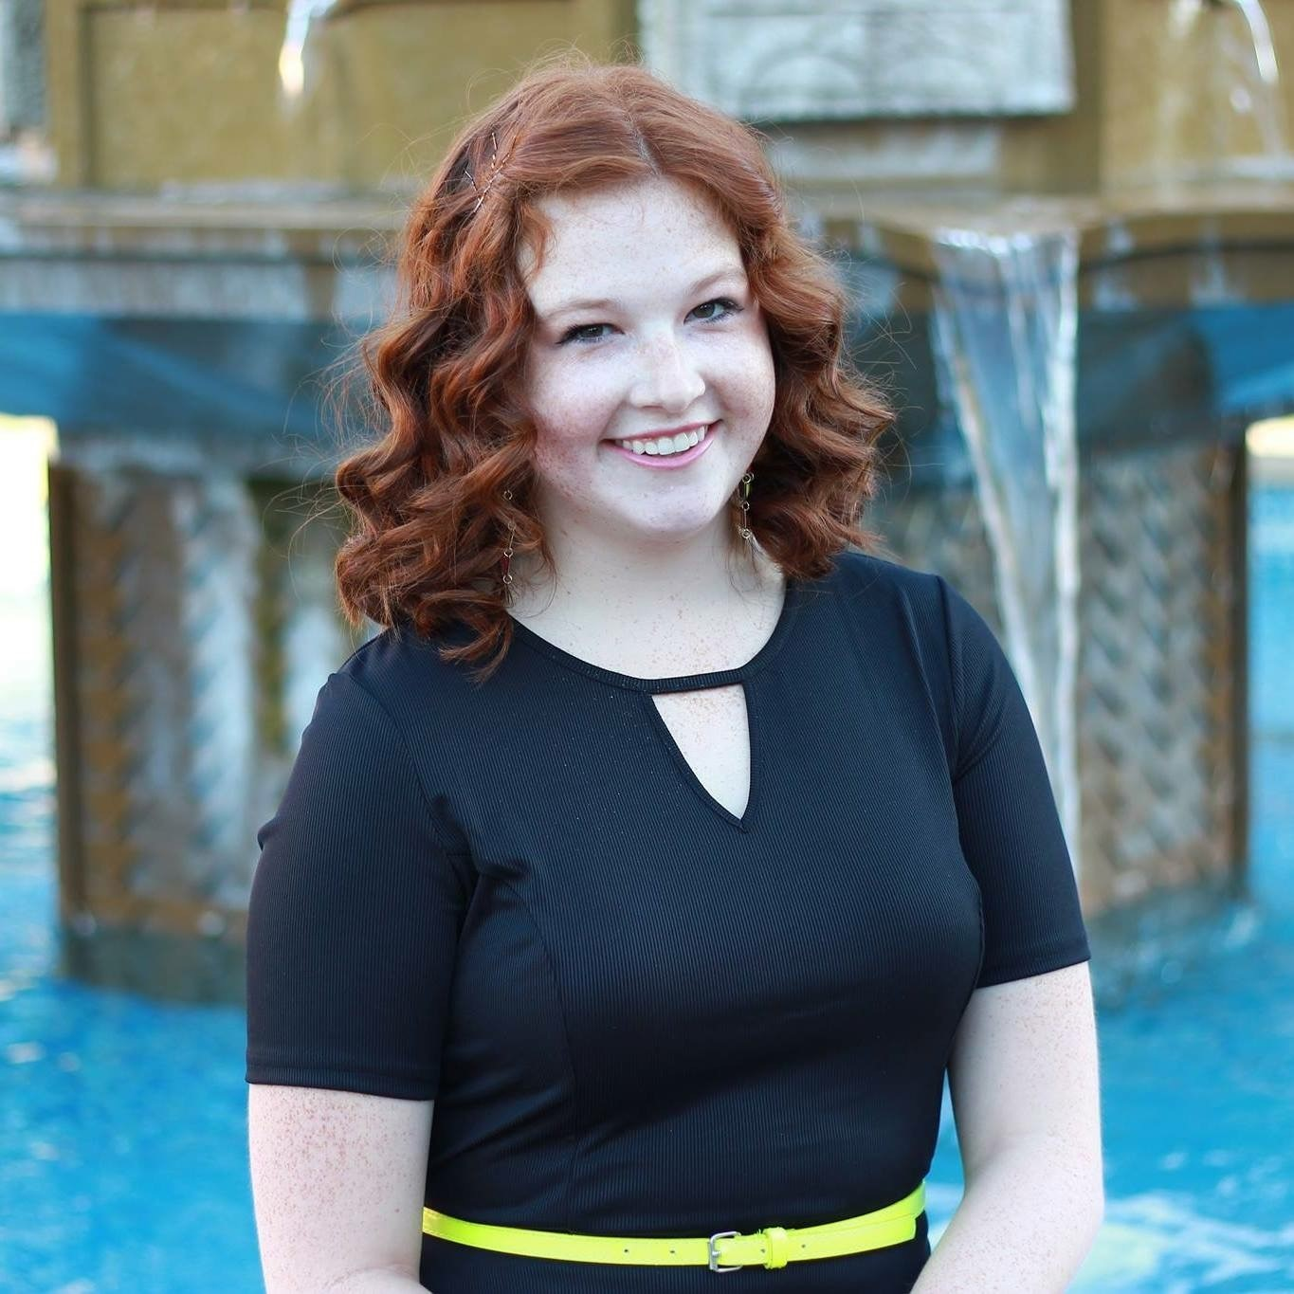
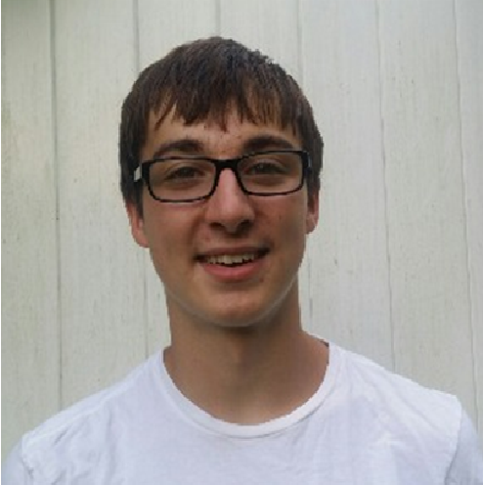
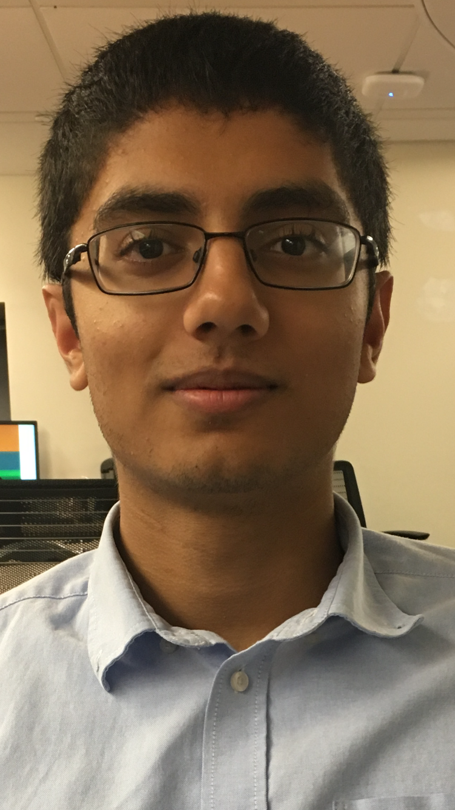
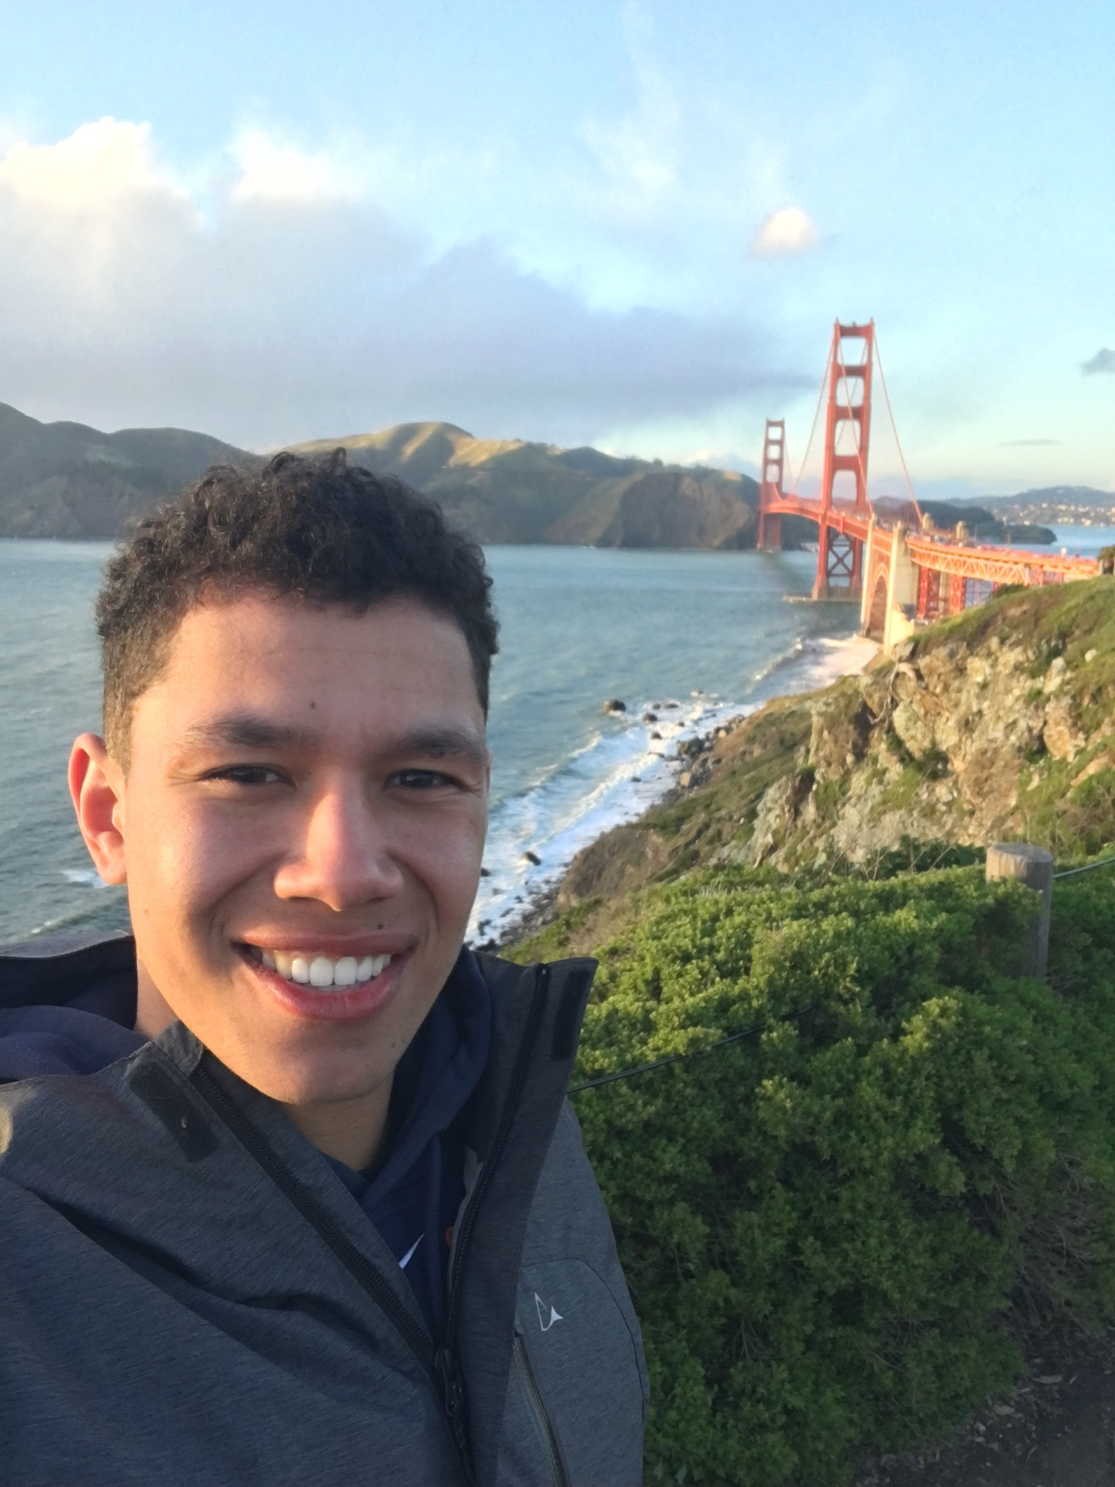
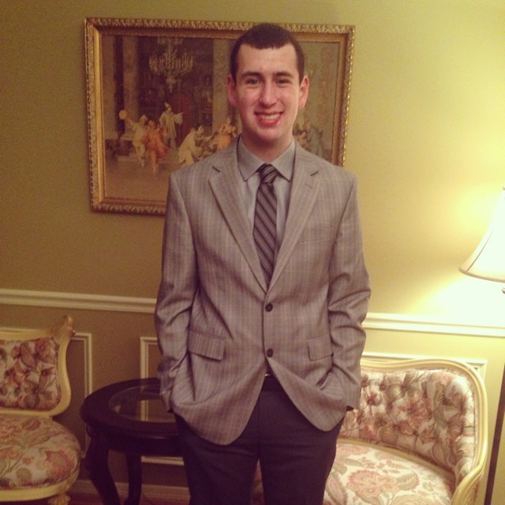
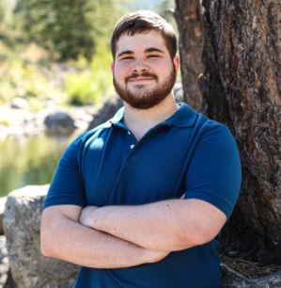
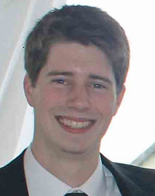
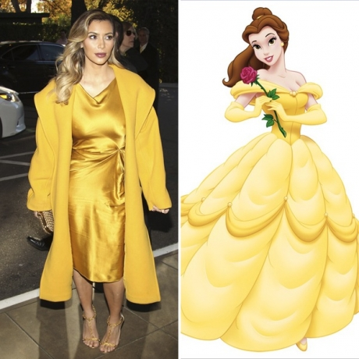

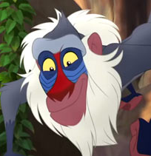




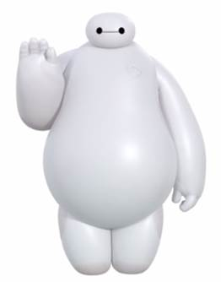

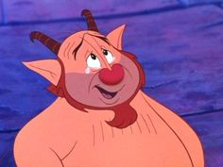
Winnovators Team
Annabelle Cormia
Inf. Sec. Eng
Wilde, CT
Brian Carducci
Developer
Wilde, CT
Jeffrey Relf
Data Engineer
Wilde, CT
Josie Lamp
Systems Analyst
Phoenix, AZ
Michael Napolitano
Inf. Sec. Eng
Wilde, CT
Neil Patel
Developer
Wilde, CT
Phil Murray
SE&I
Wilde, CT
Sal Costa
Mobility Support Specialist
Philadelphia, PA
Scott Crawford
Developer
Waterside, CT
Sean Doyle
Role
Wilde, CT
Notes:
Cigna’s mission is to improve the health, well being and sense of security of those we serve, and yoUV allows Cigna to really hit home on that message. By utilizing our innovative, proactive, and preventative application and partnering with great clients like Disney, we can save money, provide innovative technology solutions to solve today’s pressing problems and most importantly improve the health, security and overall wellbeing of our community.
Thank you for your time and with that I would like to invite up the rest of the innovators team to take your questions

Slide 18
Appendix

Slide 19
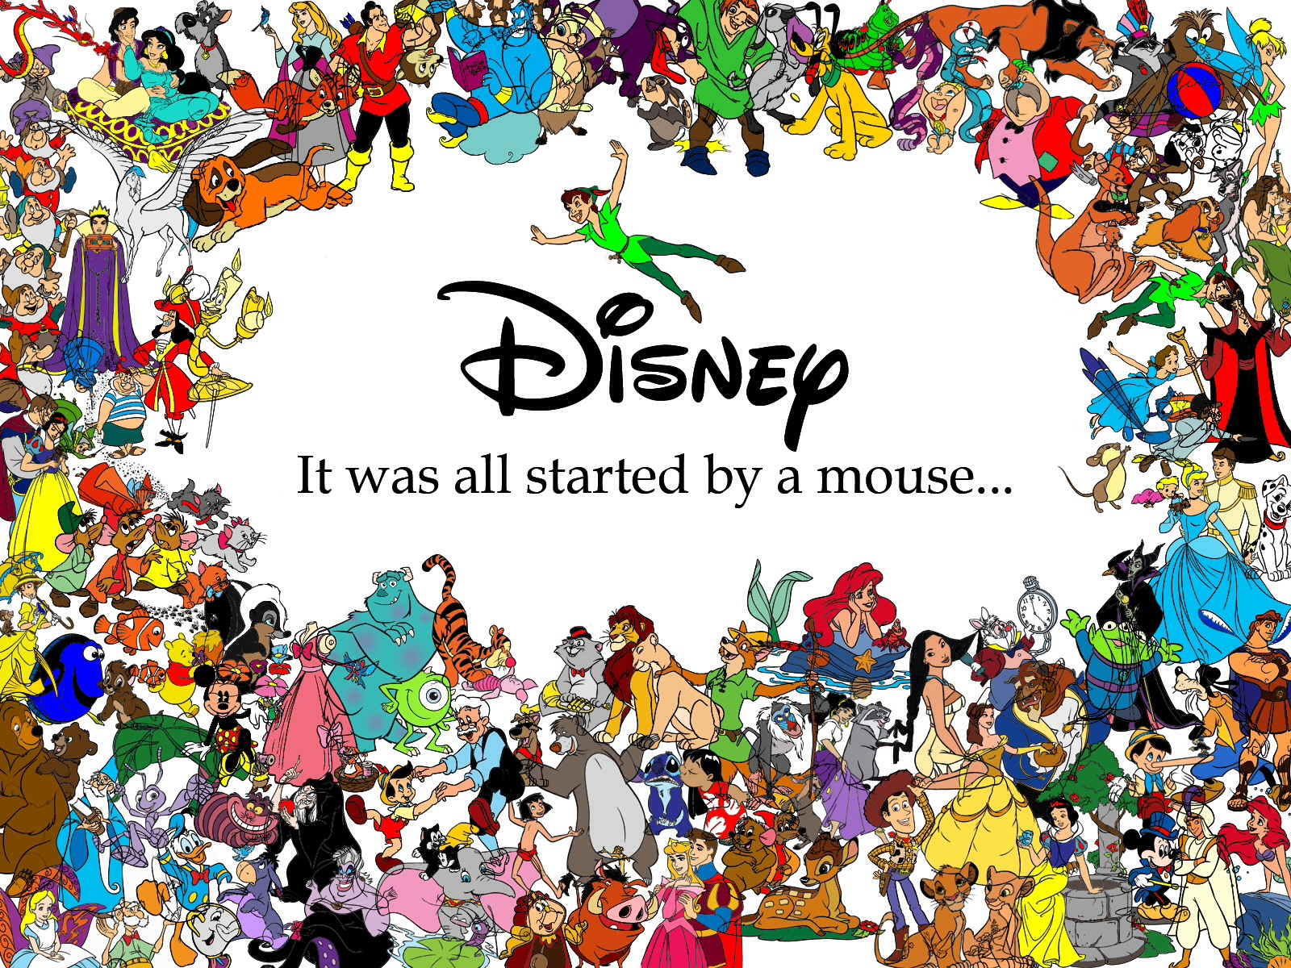
Disclaimer
Not for commercial use. We hold no rights to any of the characters used in this presentation. All rights belong to The Walt Disney Company.

Slide 20
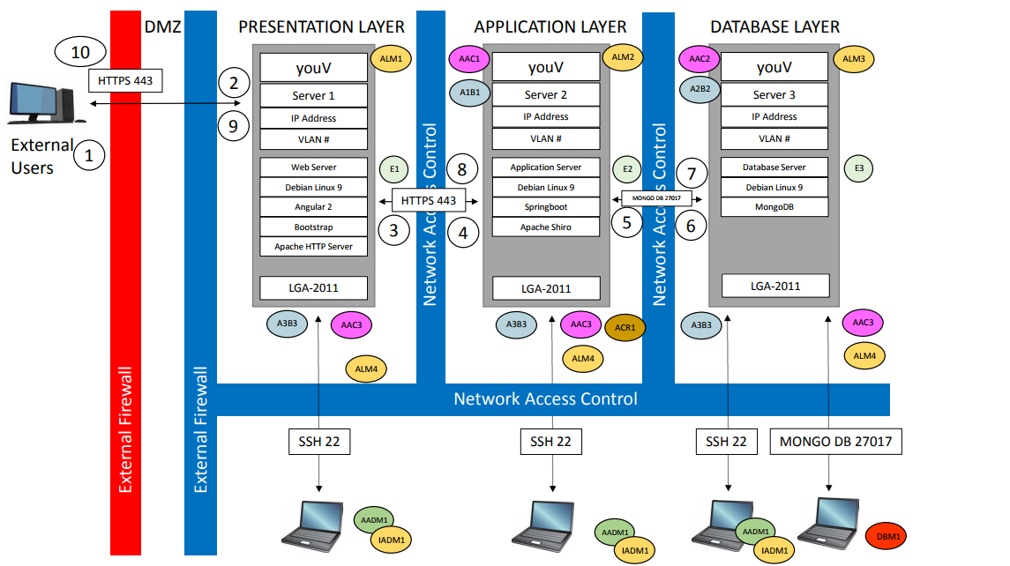
Security Architecture Diagram

Slide 21
Security
Possible concerns:
Collection of personal data
This is an issue because anytime you ask for sensitive information, people are not entirely willing to give it up due to potential security risks
Integration with the Disney application
Anytime you hand data that is safe in one location to another group, there is the risk of loss

Slide 22
How much does this save Cigna?
Stage of Melanoma | Year 3 | Year 4 | Year 5 | Total
Local (Stage 0/1) | $290,000 | $1,330,000 | $2,225,000 | $3,845,000
Regional (Stage 2) | $140,000 | $640,000 | $1,070,000 | $1,850,000
Distant (Stage 3/4) | $23,000 | $110,000 | $180,000 | $313,000
Unstaged | $40,000 | $185,000 | $310,000 | $535,000
Total | $493,000 | $2,265,000 | $3,785,000 | $6,543,000
Over the course of 5 years, this application will save Cigna over $1 million
Notes:
Josie
Cost of melanoma varies by stage, treating more advanced stages is more expensive
Assumes a 25% reduction in treatment costs and 50,000 users at year 5
https://www.ncbi.nlm.nih.gov/pmc/articles/PMC4495902/#R16
https://www.aad.org/media/stats/conditions/skin-cancer
https://seer.cancer.gov/archive/csr/1975_2011/browse_csr.php?sectionSEL=3&pageSEL=sect_03_table.08.html#table3

Slide 23
In-Depth Cost Breakdown- Development
Hours per year | 2080
Application Development | App Dev Spec ROLE |  |  | 42.47
Project Management | Project Mgmt Spec |  |  | 48.13
QA Testing | QA & Test Spec |  |  | 43.76
Dev Costs: | 3 months | 3 devs | 2 devs
 | $ 88,337.60 | $ 66,253.20 | $ 44,168.80
PM: | 9 Months
 | $ 150,165.60
Dev Ops: | 6 months
 | $ 100,110.40
Total: | $ 347,613.60 | $ 325,529.20 | $ 303,444.80
LONG TERM | $ 147,337.60
Incentive | $ 1,500,000.00

Slide 24
In-Depth Cost Breakdown- Maintenance
Year 4 | $ 1,647,337.60 |  |  |  | Application Development | App Dev Spec ROLE |  |  | 42.47
Year 5 | $ 2,647,337.60 |  |  |  | Project Management | Project Mgmt Spec |  |  | 48.13
5-year Total Cost Estimates | $ 5,314,902.40 |  |  |  | QA Testing | QA & Test Spec |  |  | 43.76
 | $ 672,613.60
 |  |  |  |  | Hours per year | 2080
 |  |  |  |  | Incentives 30,000 | $ 1,500,000.00
 |  |  |  |  | Incentives 50,000 | $ 2,500,000.00

Slide 25
In-Depth Cost Breakdown- Pilot 1
Hours per year | 2080
Application Development | App Dev Spec ROLE |  |  | 42.47
Project Management | Project Mgmt Spec |  |  | 48.13
QA Testing | QA & Test Spec |  |  | 43.76
Dev Costs: | 3 months | 3 devs | 2 devs
 | $ 88,337.60 | $ 66,253.20 | $ 44,168.80
PM: | 9 Months
 | $ 150,165.60
Dev Ops: | 6 months
 | $ 100,110.40
Total: | $ 347,613.60 | $ 325,529.20 | $ 303,444.80
LONG TERM | $ 147,337.60
Incentive | $ 150,000.00
Pilot 1 Cost | $ 497,613.60

Slide 26
In-Depth Cost Breakdown- Pilot 2
Hours per year | 2080
Application Development | App Dev Spec ROLE |  |  | 42.47
Project Management | Project Mgmt Spec |  |  | 48.13
QA Testing | QA & Test Spec |  |  | 43.76
Dev Costs: | 3 months | 3 devs | 2 devs
 | $ 88,337.60 | $ 66,253.20 | $ 44,168.80
PM: | 9 Months
 | $ 150,165.60
Dev Ops: | 6 months
 | $ 100,110.40
Total: | $ 347,613.60 | $ 325,529.20 | $ 303,444.80
LONG TERM | $ 147,337.60
Incentive | $ 500,000.00
Pilot 2 Cost | $ 847,613.60

Slide 27
In-Depth Cost Breakdown- Savings
 |  |  | Total Cost | Money Saved by a 25% reduction - Year 3 | Money Saved by a 25% reduction - Year 4 | Money Saved by a 25% reduction - Year 5
Local/Stage 0/1 | 76% | $ 11,714.50 | $ 5,341,812.00 | $ 289,348.15 | $ 1,335,453.00 | $ 2,225,755.00
Regional/2 | 16% | $ 26,667.00 | $ 2,560,032.00 | $ 138,668.40 | $ 640,008.00 | $ 1,066,680.00
Distant3/4 | 2% | $ 35,704.50 | $ 428,454.00 | $ 23,207.93 | $ 107,113.50 | $ 178,522.50
Unstaged | 5% | $ 24,695.33 | $ 740,860.00 | $ 40,129.92 | $ 185,215.00 | $ 308,691.67
Users - Year 4 | 30000 | Total | $ 9,071,158.00 | $ 491,354.39 | $ 2,267,789.50 | $ 3,779,649.17
Users - Year 3 | 6500
Users - Year 5 | 50000 |  | Total over 3 Years Savings |  | $ 6,538,793.06
 |  |  | Difference over 5 years |  | $ 1,223,890.66
 |  |  |  | Reduction Rate | 0.25
 |  |  |  | Skin Cancer Rate | 0.02

Slide 28
Melanoma Overview
Type of skin cancer that originates in melanocytes (the cells that produce melanin within the epidermis) caused by UV exposure
Risk factors
Fair skin, light hair, freckles
Skin sensitivity
Past sunburn history
Amount of UV exposure
Higher elevations
Proximity to the equator
Increased number of moles on body
Family history of Melanoma
Weakened immune system
Increased Age

